Slide 1
Import data from the web
Import data from the web

Slide 2
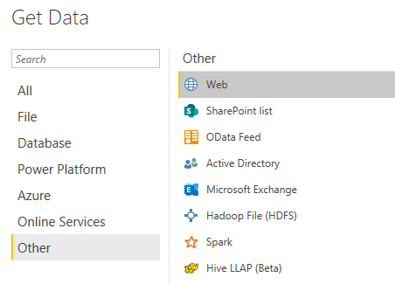
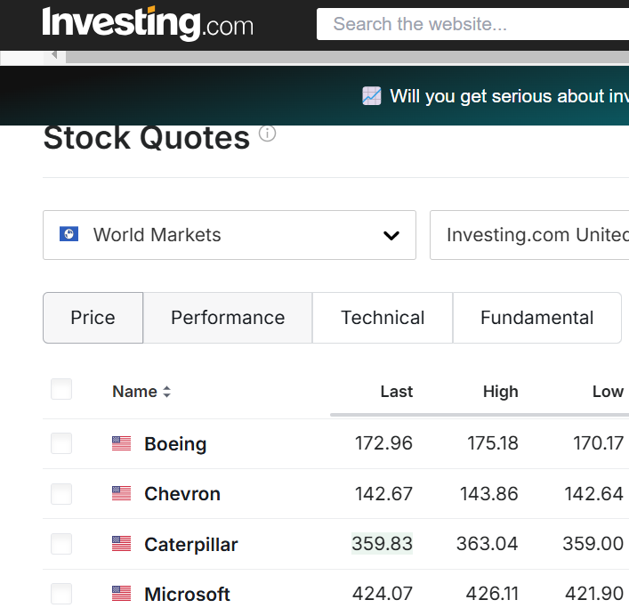
Import data from the web
Select a web source
Navigate to https://www.investing.com/equities​​ and observe the data

Slide 3
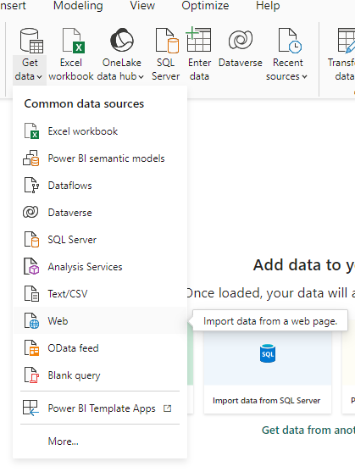
Import data from the web
Select a data source
1
2

Slide 4
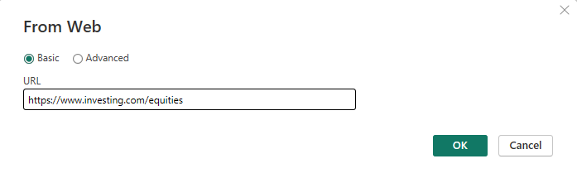
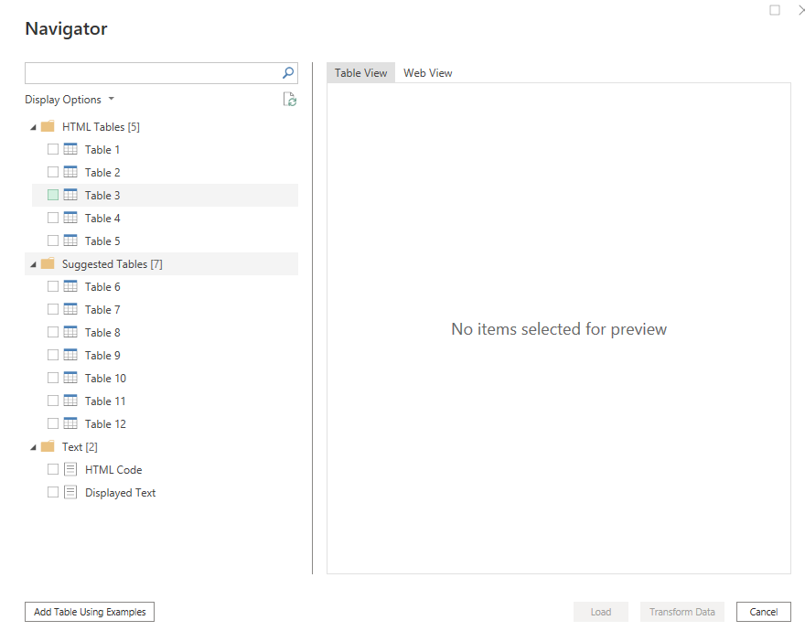
Import data from the web
In the URL field, enter the link, then click Next , choose​ authentication Anonymous ,
Then Click OK .​
Try navigating between the two tabs: Table View and Web View .

Slide 5
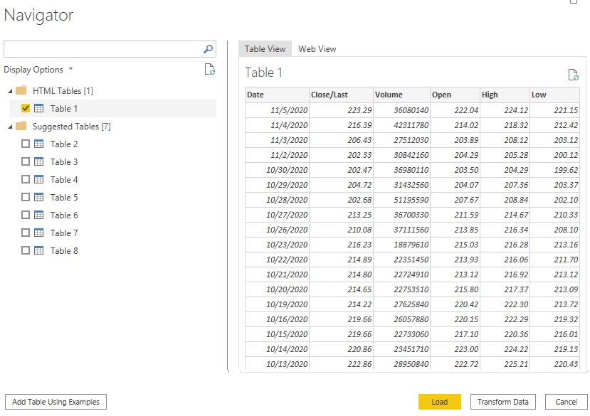
Import data from the web
Try navigating between the two tabs Table View and Web View .

Slide 6
Thank you
Thank you

